Slide 1
Basic Electronics for Computer Scientists
Dr Chris Dennett

Slide 2
Today’s Lecture
Basic units in electricity
Understanding how these units relate to each other – The hydraulic analogy
Ohm’s Law
Components
Analogue vs Digital electronics
Basic components

Slide 3
Basic Units
The three most basic units in electricity are
Voltage (V) measured in Volts
Current (I) measured in Amps
Resistance (r) measured in Ohms (Ω)
These three units, along with power (measured in Watts) are all related by simple equations.
We’ll get to them later

Slide 4
The Hydraulic Analogy
Understanding how an electronic circuit functions can be difficult to describe
The Hydraulic Analogy helps us to visualise this
Within limits, it explains the circuits you’ve been building right up to the electricity grid… with plumbing!
We’ll use it to describe some of the various components and concepts that are found in an electronic circuit

Slide 5
Electronic Components
The simplest component?
Wire
Analogous to a water pipe filled with water
When it is unconnected, think of it as a pipe full of water with caps on the end.
When it is connected to something, imagine that the cap has been removed at that end.

Slide 6
Electronic Components
Voltage
Also known as Potential Difference
Like the difference in pressure in two places
Less Pressure
More Pressure

Slide 7
WHAT IS ELECTRICITY ?
An atom has a cloud of electrons around it and in a conductor the outer most ones can be easily made to move through the material.
It is this movement of these electrons, which are charged particles, that constitute a flow of current – or electricity as it is sometimes referred to.

Slide 8
Electronic Components
Current
Analogous to the amount of water flowing out of the pipe over time
So
A large pipe allows more water to flow through it
A connected wire is like a large pipe

Slide 9
Electronic Components
Voltage sources
Strictly speaking – Ideal voltage sources
Here we’re talking about power sources
Batteries, power supplies etc
Analogous to a pump that doesn’t care about how much current is flowing through it but maintains the difference in pressure across it

Slide 10
Electronic Components
Think of a pipe that gets thinner for a bit.
To get the same amount of flow through the thinner part, we’d have to increase the pressure.
If we couldn’t increase the pressure, the flow would reduce.
The thin bit is like a resistor
A variable resistor changes the width of the thin bit

Slide 11
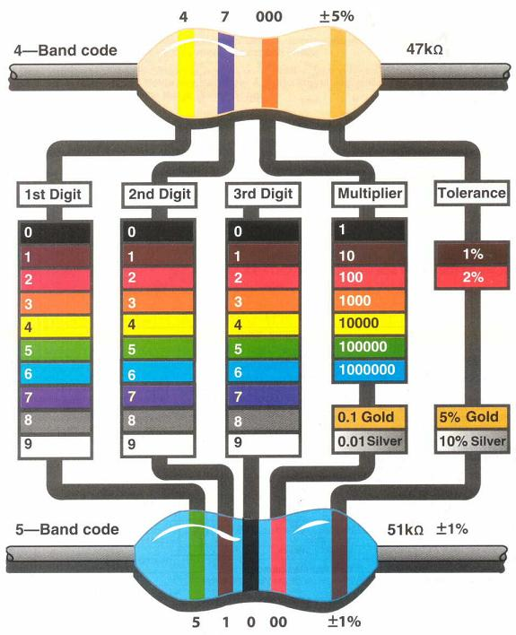
Quick Aside – Resistor Colour Code
You’ll have noticed in the workshops that I specify the colours of the bands on resistors.
The bands define the resistance rating and how exact that is

Slide 12
Electronic Components
Switch
Equivalent to a valve that is only on or off
Some switches work such that you open a circuit (switch to break contact). Stopping the flow
others work such that you close a circuit (switch to make contact). Allowing flow through

Slide 13
From Analogy to Ohm’s Law
From the water analogy, we can see that pressure, flow and the size of the pipe are related.
Reduce the size of the pipe and you constrict the flow. Increase it and the flow increases.
Get rid of the restriction and increase the pressure. The flow of water will be greater.
If you want the water to come out quicker, you have to increase the pressure

Slide 14
Ohm’s Law
Ohm’s Law relates the electric units analogous to pressure, flow and restriction in much the same way.
V=IR
Voltage = Current X Resistance
For a given voltage, if you reduce the resistance, you increase the current
Reduce the voltage, keep the resistance the same and the current must reduce
The resistance can be calculated if you know what the voltage and current are

Slide 15
Power
There’s another important equation that can also be seen as analogous to hydraulics.
P=IV
Power (Watts) = Current X Voltage
Imagine a water wheel being driven by water coming out of a pipe.
To speed the wheel up, what can you do?
Increase the pressure of the water
Increase the amount of water coming out of the pipe

Slide 16
Analogue and Digital Electronics
Electronic signals are waveforms. They change continuously rather than abruptly.
All circuits are analogue in that they use electronic signals
Digital electronics only considers HIGH and LOW values. Typically 0V and 5V.
This does not mean that our signal only has two values and jumps from 0V to 5V with nothing in between. It simply means that we don’t look at the transition

Slide 17
Analogue and Digital Electronics
Micro processors and micro controllers work in the digital domain.
We do have to consider the speed at which we use digital signals
Look back at your first year notes!
So what do we do when we want to integrate with the outside world?
Depends on what we’re doing

Slide 18
Talking to the outside world
Interfacing to real components brings issues that we need to consider
Resistance – both input and output
Reactance
Impedance
Loading

Slide 19

Some basic components
Resistors - from Ohm’s law
Resitance = Pressure/flow
R = V/I
I
V

Slide 20
Potential divider
If we put 2 resistors in series together then both will impede current flow and hence get a voltage drop will occur over each.
I
V1 = V( R1 )
R1 + R2
1
2
V1
V2
V

Slide 21
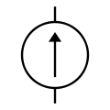

Internal resistance
We can get a 12 V car battery to start a car engine, alternatively we can put 8 AAA batteries in series to give 12V. We intuitively know that this could not start a car
A battery can be modelled as a power supplied with an internal resistance in series with it. This limits the current it can deliver

Slide 22
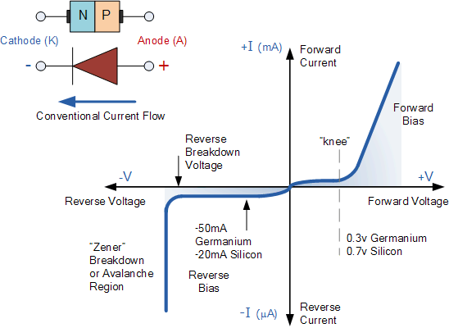
Some simple circuits – a diode
Diode may have two purposes
to let current flow only in one direction (forward biased)
or to set a maximum voltage (reversed biased)

Slide 23

Uses of diodes
Like a one way valve they will only let current flow in one direction – used in ac/dc convertors, or LEDs.
In forward bias once the applied voltage exceeds the threshold V – the current will rise dramatically
Need to put a resistor in series to throttle this

Slide 24
Electronic Components
Transistor
There are different kinds of transistor. But the effect is something like this:
There’s a pipe with a valve that controls the flow through it.
The valve is controlled by a plunger in a smaller pipe.
The valve is closed until a certain amount of current (or pressure… but we’ll cover that later) forces the valve to open, allowing current to flow through the larger pipe

Slide 25

Transistors
Transistors are generally used to allow a very small signal to generate a much larger one (amplifier) – used in guitar amplifiers and so on
or use a very small current to recreate a much larger one to power something – drive an electric motor
Signal is applied to B the base
And a steady power supply is connected across C collector and E the emitter
The signal will cause a large current to be passed through the transistor and this could be used to power a loudspeaker etc, (actually further components are needed to create a suitable circuit)

Slide 26
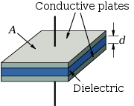
Capacitors
These are simply two plates of metal separated by an insulator (dielectric) – application of a voltage causes electrons to flow to these plates so although the current cannot pass through the insulator in the middle there is a current in the wires leading to it
The change in the voltage causes more charges to flow to or from the plates
The faster the change in V the greater the current that will flow
Intuitively we can see from this that the current flowing is related to frequency f of the voltage change, and the magnitude of the capacitance C which is related to the area of the plates
This gives us a new term Xc analogous to Resistance called Reactance
C = A ε/d
And
I= V.2π f C
I= V. Xc

Slide 27

Inductors
A coil of wire has a another property called inductance L which stems from a changing current within it. The magnitude of this L is dependent on it’s physical size Length l, number of turns N in the coil and the magnetic properties µ of the material within the coil .
This phenomenon of inductance opposes a changing current I in it
Which implies that I is proportional to the inverse of L and the frequency f of the current change
This gives us a new term X_{L} analogous to Resistance called Reactance
L = N²µA/ l
V = I/2 π fL
X_{L =} 2 π fL

Slide 28

Reactance and impedance
We can see that as the frequency of a signal increases the reactance of a capacitor decreases and it will pass more current through it, whereas the opposite occurs with an inductor
If a circuit has both resistors, capacitors and inductors in it then there is both resistance and reactance involved
Both of these will limit current and causes voltage drops across them
The sum of reactance and resistance is called impedance Z is calculated by
X_{T}² = X_{C} + X_{L}
$Z= \sqrt{\text{X}\text{T}\text{2}\text{+ }\text{R}\text{2} }$

Slide 29
Input and output impedance
A pin configured as an Input on an Arduino has an impedance of 100 MegOhms
At 5V this would draw only 0.00000005 Amps – this would not load the input source and hence the voltage at the input of the Arduino would be the same as that generated by the input source
A pin configured as an output has a low output impedance but can only deliver 40mA
This is enough to power an LED, but not a relay, motor etc. You will need some interface circuitry if you wish to draw more than 40mA

Slide 30
A/D conversion
We’re not going to look at the specifics of Analogue to Digital conversion
We’re leaving that for Ian!
When reading an analogue signal, we look at the value of the signal and convert it to a binary value
When providing a signal, we convert the binary value to an analogue value
We do both of these things many times over the signal, producing a ‘stepped’ version

Slide 31
Pulse-Width Modulation
Pulse-Width Modulation can also be used to give an analogue signal.
We create a square wave.
By altering the amount of time the square wave is HIGH, compared to the amount of time it is LOW, we simulate different voltages
100% Cycle = Fully On
30% Cycle = Third of full voltage
0% Cycle = Fully Off

